Slide 1
Session 3
Chapter 2 - Relational Database Modeling - Part 2
Database Systems

Slide 2
Objectives
1
Understand why do we need Algebraic Query Language
2
Understand how Algebraic Query Language work

Slide 3
Contents
1
Why do we need Algebraic Query Language
2
An Algebraic Query Language

Slide 4
2.4. An Algebraic Query Language

Slide 5
2.4.1. Why do we need a special Query Language?
One should ask why we need a new kind of programming languages for databases?
Won’t conventional languages like C or Java suffice to ask and answer any computable question about relations? Because we can represent a tuple of a relation by struct (in C) or an object (in Java) and we can represent relations by arrays of these elements.
The surprising answer is that RA is useful because it is less powerful than C or Java

Slide 6
2.4.2. What is an Algebra?
An algebra, in general, consist of operators and atomic operands
RA is another example of an algebra: its atomic operands are:
  Variables that stand for relations
  Constants, which are finite relations

Slide 7
2.4.2. Relational algebra definition
Relational algebra, an offshoot of algebra of sets via operators
Operators operate on one or more relations to create a new relation

Slide 8
2.4.3 Overview of relational algebra
In any algebra, some operators are primitive and the others, being definable in terms of the primitive ones, are derived
The six primitive operators of relational algebra are:
  the SELECTION,
  the PROJECTION,
  the CARTESIAN PRODUCT (also called the cross product or cross join),
  the SET UNION
  the SET DIFFERENCE, and
  the RENAME

Slide 9
2.4.4. Set Operations on Relations - Set Union
Sells1
bar | beer | price
Joe's | Bud | 2.50
Joe's | Miller | 2.75
Sue's | Bud | 2.50
Sells2
bar | beer | price
Joe's | Bud | 2.50
Joe's | Miller | 2.75
Sue's | Miller | 3.00
Sells1 U Sells2
bar | beer | price
Joe's | Bud | 2.50
Joe's | Miller | 2.75
Sue's | Bud | 2.50
Sue's | Miller | 3.00

Slide 10
2.4.4. Set Operations on Relations - Set Except
Sells1
bar | beer | price
Joe's | Bud | 2.50
Joe's | Miller | 2.75
Sue's | Bud | 2.50
Sells2
bar | beer | price
Joe's | Bud | 2.50
Joe's | Miller | 2.75
Sue's | Miller | 3.00
Sells1 \ Sells2
bar | beer | price
Sue's | Bud | 2.50

Slide 11
2.4.4. Set Operations on Relations - Set Intersection
This
Sells1
bar | beer | price
Joe's | Bud | 2.50
Joe's | Miller | 2.75
Sue's | Bud | 2.50
Sells2
bar | beer | price
Joe's | Bud | 2.50
Joe's | Miller | 2.75
Sue's | Miller | 3.00
Sells1 ∩ Sells2
bar | beer | price
Joe's | Bud | 2.50
Joe's | Miller | 2.75

Slide 12
2.4.5. Projection
R1 := π_{L} (R2)
  L is a list of attributes from the schema of R2.
  R1 is constructed by looking at each tuple of R2, extracting the attributes on list L, in the order specified, and creating from those components a tuple for R1.
  Eliminate duplicate tuples, if any.

Slide 13
Example: Projection
Relation Sells:
bar beer price
Joe’s Bud 2.50
Joe’s Miller 2.75
Sue’s Bud 2.50
Sue’s Miller 3.00
Prices := π_{beer, price}(Sells):
beer price
Bud 2.50
Miller 2.75
Miller 3.00

Slide 14
Extended Projection
Using the same π_{L} operator, we allow the list L to contain arbitrary expressions involving attributes:
    Arithmetic on attributes, e.g., A+B->C.
    Duplicate occurrences of the same attribute.

Slide 15
Example: Extended Projection
R = ( A B )
1 2
3 4
π_{A+B->C, A, A} (R) = C A1 A2
3 1 1
7 3 3

Slide 16
2.4.6. Selection
R1 := σ_{C} (R2)
  C is a condition (as in “if” statements) that refers to attributes of R2.
  R1 is all those tuples of R2 that satisfy C.

Slide 17
Example: Selection
Relation Sells:
bar beer price
Joe’s Bud 2.50
Joe’s Miller 2.75
Sue’s Bud 2.50
Sue’s Miller 3.00
JoeMenu := σ_{bar=“Joe’s”}(Sells):
bar beer price
Joe’s Bud 2.50
Joe’s Miller 2.75

Slide 18
2.4.7. Product
R3 := R1 Χ R2
  Pair each tuple t1 of R1 with each tuple t2 of R2.
  Concatenation t1t2 is a tuple of R3.
  Schema of R3 is the attributes of R1 and then R2, in order.
  But beware attribute A of the same name in R1 and R2: use R1.A and R2.A.

Slide 19
Example: R3 := R1 Χ R2
R1( A, B )
1 2
3 4
R2( B, C )
5 6
7 8
9 10
R3( A, R1.B, R2.B, C )
1 2 5 6
1 2 7 8
1 2 9 10
3 4 5 6
3 4 7 8
3 4 9 10

Slide 20
2.4.8. Natural Join
A useful join variant (natural join) connects two relations by:
  Equating attributes of the same name, and
  Projecting out one copy of each pair of equated attributes.
Denoted R3 := R1 ⋈ R2.

Slide 21
Example: Natural Join
Sells( bar, beer, price ) Bars( bar, addr )
Joe’s Bud 2.50 Joe’s Maple St.
Joe’s Miller 2.75 Sue’s River Rd.
Sue’s Bud 2.50
Sue’s Coors 3.00
BarInfo := Sells ⋈ Bars
Note: Bars.name has become Bars.bar to make the natural
join “work.”
BarInfo( bar, beer, price, addr )
Joe’s Bud 2.50 Maple St.
Joe’s Milller 2.75 Maple St.
Sue’s Bud 2.50 River Rd.
Sue’s Coors 3.00 River Rd.

Slide 22
2.4.9 Theta Join
R ⋈ _{θ} S
The result of theta join consists of all combinations of tuples in two relations R and S that satisfy θ condition

Slide 23
Example: Theta Join
R
A | B
1 | 1
1 | 2
2 | 3
S
C | D
2 | 2
3 | 2
4 | 1
R⋈_{B>=C}S
A | B | C | D
1 | 2 | 2 | 2
2 | 3 | 2 | 2
2 | 3 | 3 | 2

Slide 24
2.4.11. Renaming
The ρ operator gives a new schema to a relation.
R1 := ρ_{R1(A1,…,An)}(R2) makes R1 be a relation with attributes A1,…,An and the same tuples as R2.
Simplified notation: R1(A1,…,An) := R2.

Slide 25
Example: Renaming
Bars( name, addr )
Joe’s Maple St.
Sue’s River Rd.
R(bar, addr) := Bars
R( bar, addr )
Joe’s Maple St.
Sue’s River Rd.

Slide 26
2.4.11 Combining Operations to Form Queries
Movies (title, year, length, genre, studioName)
What are titles and years of movies made by Fox that are at least 100 minutes long?
To answer above question, see the steps represented as an expression tree:
π_{title, year}
∩
σ_{length >= 100}
σ_{studioName = ‘Fox’}
Movies
Movies

Slide 27
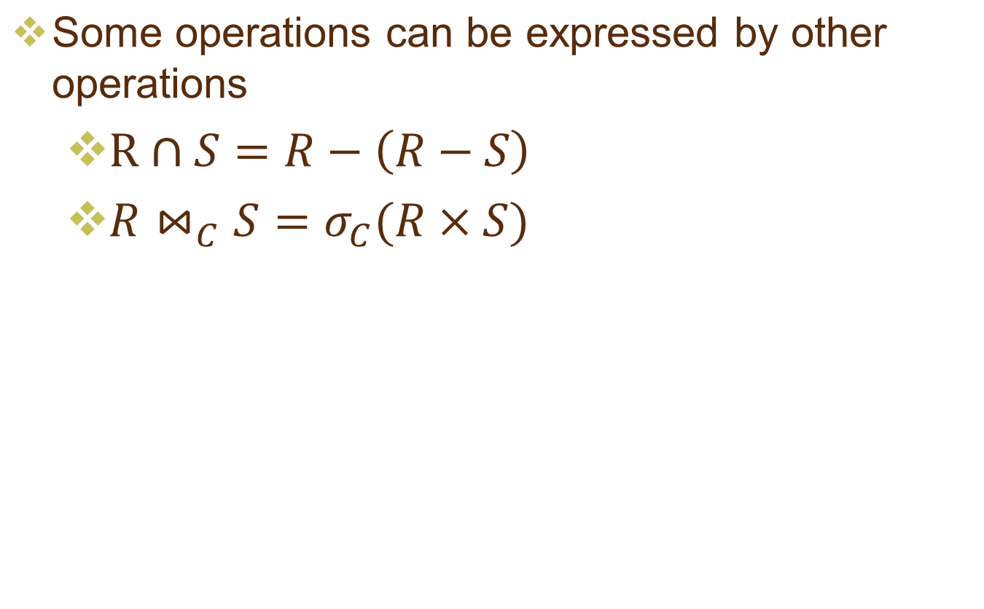
2.4.12 Relationships among operations

Slide 28
2.4.13 Exercises
A database schema consist of 4 relations:
  Product(maker, model, type)
  PC(model, speed, ram, hd, price)
  Laptop(model, speed, ram, hd, screen, price)
  Printer(model, color, type, price)
  https://github.com/himahb/hima226/blob/master/computers.sql

Slide 29
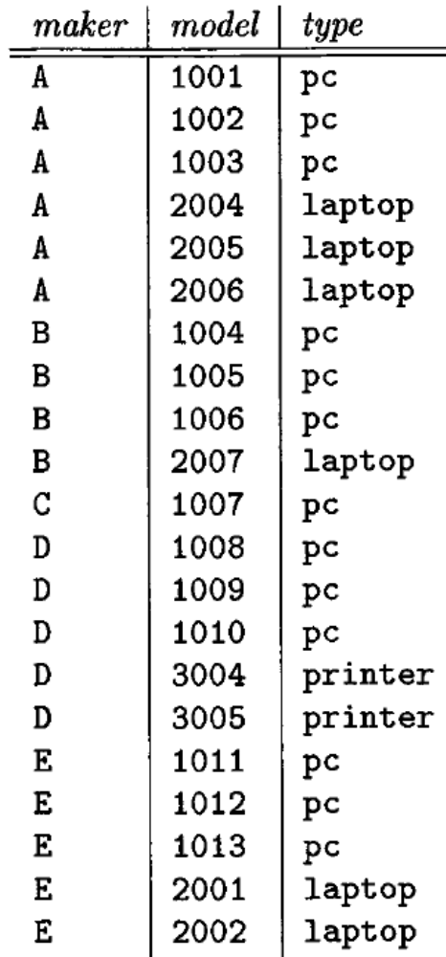
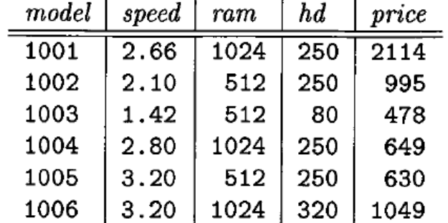
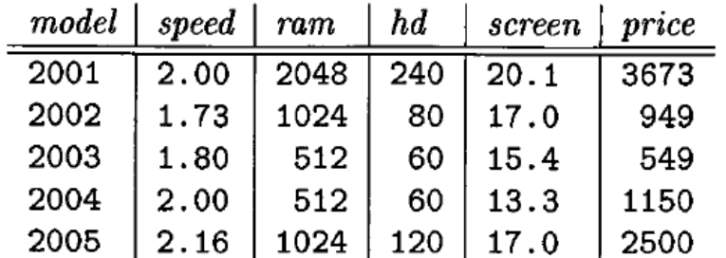
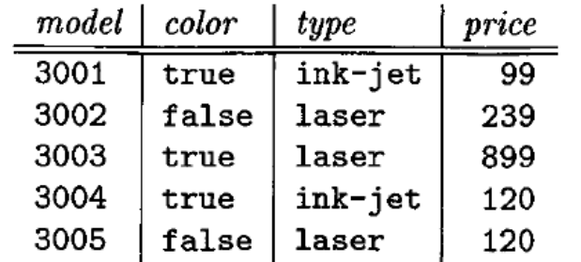
2.4.13 Exercises
Samples data for 4 relations
PC
Product
Laptop
Printer

Slide 30
2.4.13 Exercises
Write expression of relational algebra to answer the following queries:
  What types of product made by manufacturer A?
  What PC models have a speed of at least 3.00?
  What types of product made by both manufacturers A and D?
  What types of product made by manufacturer A but not by manufacturer D?
  Which manufacturers make laptops with a hard disk of at least 100GB?
  Find the model numbers and price of all products (of any type) made by manufacturer B?
  Find the model number of all color laser printers?
  Find those manufacturers that sell Laptops, but not PC’s.
  Find those hard-disk sizes that occur in two or more PC’s.
  Find the manufacturers of the computer with the highest available speed.
  Find those manufacturers of at least two different computers (PC or laptop) with speeds of at least 2.80.
Product(maker, model, type)
PC(model, speed, ram, hd, price)
Laptop(model, speed, ram, hd, screen, price)
Printer(model, color, type, price)

Slide 31
Summary
RA is more useful than C or Java because it is less powerful.
RA is an algebra: its atomic operands are:
  Variables that stand for relations
  Constants, which are finite relations
The six primitive operators of RA are: Selection, Projection, Product, Union, Difference (Except) and Rename
Other operators of RA are: Natural Join, Theta Join, …

Slide 32
Summary
RA is more useful than C or Java because it is less powerful.
RA is an algebra: its atomic operands are:
  Variables that stand for relations
  Constants, which are finite relations
The six primitive operators of RA are: Selection, Projection, Product, Union, Difference and Rename
Other operators of RA are: Natural Join, Theta Join, …

Slide 33
Thank You !

